Slide 1
https://powercybertestbed.ece.iastate.edu/
PUSH ALL WORK TO GITLAB AND IN VM!!!!!1!!!

Slide 2
Week 7

Slide 3
Who are Present Today
Tyler, Zach, Justin, Matt, Kaya, Tommy

Slide 4
Kaya - Work
No matter how I configured the types, it didn’t help. The -9999 issue is not a type mismatch.
Realized battery/charger uses time intervals, instead of sending values at one specific time. Added that.
Realized sender isn’t actually requesting time, so added that.
Looked around more to spot timing conflicts, but -9999 issue is still pervasive.
Reverted back to original sender/receiver to slowly add things again, maybe I missed something.

Slide 5
Kaya - Work
Realized there was a warning in the logs I missed, sender’s publication was not being initialized.
Very confused why sender/receiver were actually working if the pubs and subs weren’t initialized properly. Currently think that I’ve been both initializing pubs/subs using the old helics methodology (what the pi example originally utilized), as well as implementing them from the json config. May explain why it was working, and why properly implementing the config created a duplicate federate error.
Sender/receiver has been patchwork/frankenstein code from the beginning, taken from an old example and modified. This has resulted in bad names, confusing variables etc.
Both the federate and the pubs/subs are called very similar things. Federate was called “TestA” and the sub was also called “testA”.

Slide 6
Kaya - Work
Tried to make pi example as close to the charger/battery example as possible.
Duplicate pub/sub issue was due to a misunderstanding. Both federates cannot publish to the same pub I don’t think?
First value is the -99999, but I think that’s a timing mismatch issue. Other values get sent across correctly now.
Not entirely sure how to do 1 pub/sub, so I implemented multiple like in the Helics charger example.

Slide 7
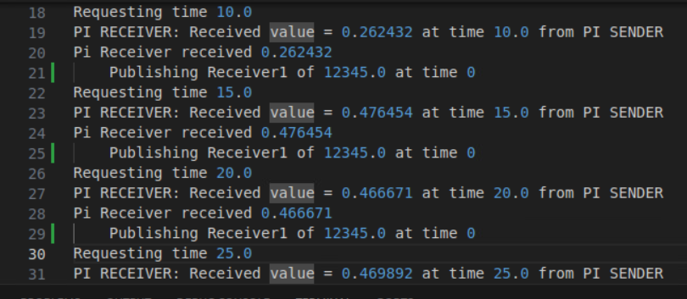
Kaya - Work
Got bidirectionality to work
Some kinks:
Sender sending the entire list of values each time, receiver only gets 1 at a time like intentioned, but still weird behavior.
May need to refactor code to allow both federates to send lists of code, but unsure.

Slide 8
Kaya - Next Steps
Current state should be ready for adding pandapower and dss-python
Get both sides transmitting lists of values
Add more pubs/subs
Add controller federate

Slide 9
Tyler - Work
More research into attacks and how to do them. Looked into various IEEE papers that used various different methodologies, however, all of the ones I looked at just explained methodology and framework and not really the attack portion (see next slide for IEEE paper links).
So far, this is the list of attacks that I believe we can manage with our simulation: Load shedding through tripping breakers, causing an overload on distribution lines through putting more load than the lines can handle, causing one of the generators to “short circuit”, and causing cascading failures (not quite sure how we can do this one yet, still looking at the last paper on the next slide).
Was going to try to get one of the HELICS samples set up but I did not have time due to taking part in the NCDC this weekend. Upon talking more with Kaya, this will also be more trouble and time consuming than it is worth since it does not use Pandapower or DSSPython.

Slide 10
Tyler - Work
https://ieeexplore.ieee.org/document/9770105 - Cyber Attack Sequences Generation for Electric Power Grid
https://ieeexplore.ieee.org/document/7115395 - Integrated simulation to analyze the impact of cyber-attacks on the power grid
https://ieeexplore.ieee.org/document/10176955 - Cyber Attack Simulation and Detection in Digital Substation
https://ieeexplore.ieee.org/document/10256104 - Cyber Attacks on Power Grids: Causes and Propagation of Cascading Failures - (following up more on this one. Was not able to read through all of it. It does have an in-depth analysis of multiple different cascading failures that could be useful)

Slide 11
Tyler - Future Work
Look more into documentation and research papers for attacks to help in creating/finalizing the attack plan.
Work with Matt and Thommy to understand the specifics and anything EE related.
Get started on the Midterm Review presentation that is due on the 6th.

Slide 12
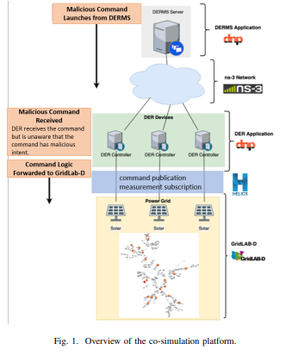
Zach - Work
Found examples of government sponsored research emulating cyber attacks on a grid. Link
The study seems to use ns-3 to simulate the network instead of docker
They have pretty well documented attacks within the paper (Going to talk with the team about feasibility)

Slide 13
Zach - Work
Another university in Germany did a similar type of project with different systems.
Link They also had well documented types of attacks I’m looking to do a feasibility check with.

Slide 14
Zach - Future Work
Get with team and go over attacks listed in the first paper presented to see if any of them would work well in our project.
Catch up with Tommy and Dss-python. See what can be done to help get it working with HELICS and DER.

Slide 15
Matt - Work
Explored importing real load EV load profiles for the Sante Fe area to match our DSS simulation
Used the US Department of energy website to view load profile data
https://afdc.energy.gov/evi-pro-lite
When downloading the load profile data, it is a very poorly formatter csv file
There was no time variable in the csv data
The output graphs on the website seem very off?
The data provided in the load profile csv appear to be power values instead of voltage and current
Could not find any other sources of load profile data that could be downloaded

Slide 16
Matt - Work
I am not sure we will be able to use this data in our simulation, but it could be possible to model something similar
If we want to model thousands of EVs, we will need to configure thousands of EV instances in the .json file. Is there a way to work around this?
I think we can model these loads based on other data provided by the website i.e. percentage of vehicle types, percentage of charging level used, and which charging application used

Slide 17
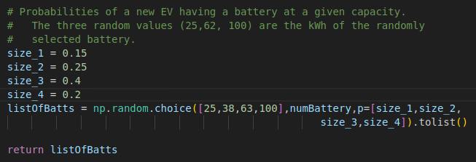
Matt - Work
The sizes and probabilities of each battery size can be changed in the simulation using the code below

Slide 18
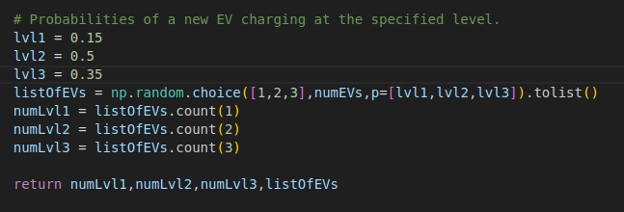
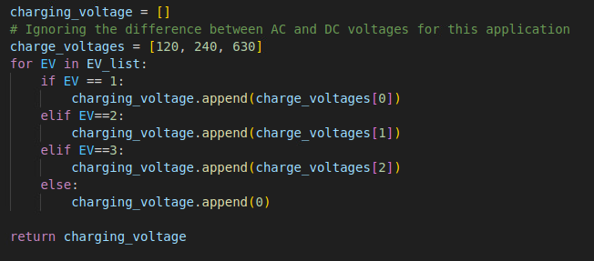
Matt - Work
Charging levels and probability of which charging level used can be changed with the code below

Slide 19
Matt - Next weeks plan
Should I look further into importing existing EV load profile data?
Expand the simulation to output more realistic profiles
Explore options for how to efficiently expand the simulation

Slide 20
Tommy - Work
Explored documentation using google collab
Started with plotting
Was able to see the correct code and see what various outputs can be used
Documentation for matplot lib for adjustments in plots https://matplotlib.org/ipympl/
Still confused on how to get santa fe model plots to show
Has been fixed

Slide 21
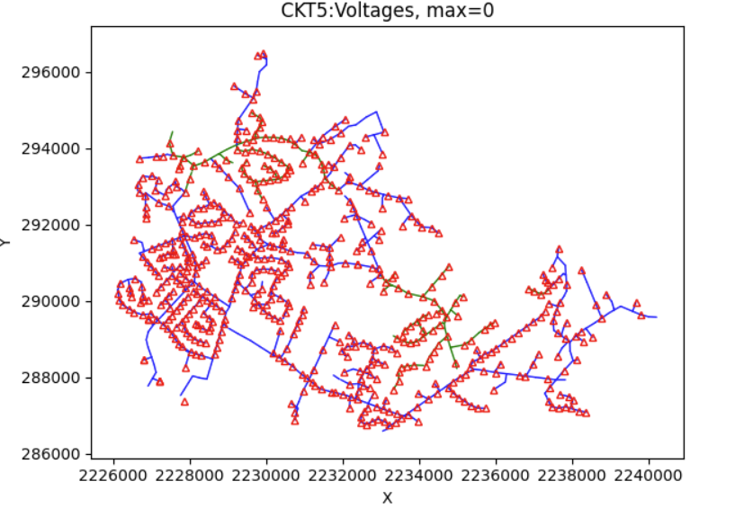
Tommy Work
Read about multiple plotting functions that would be good to send to the frontend as a result
Transformers on a plot
Will be helpful in finding changes in voltages throughout santa fe model

Slide 22
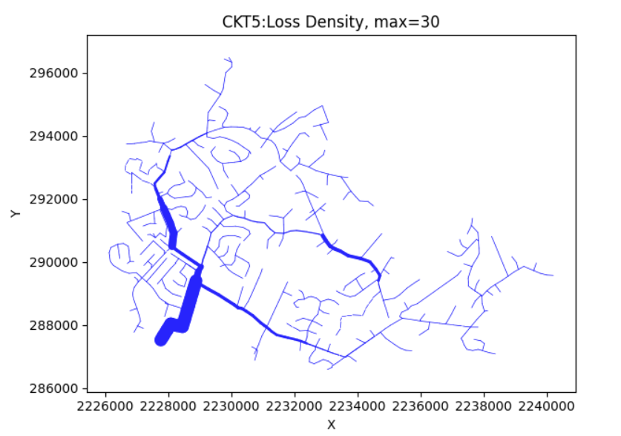
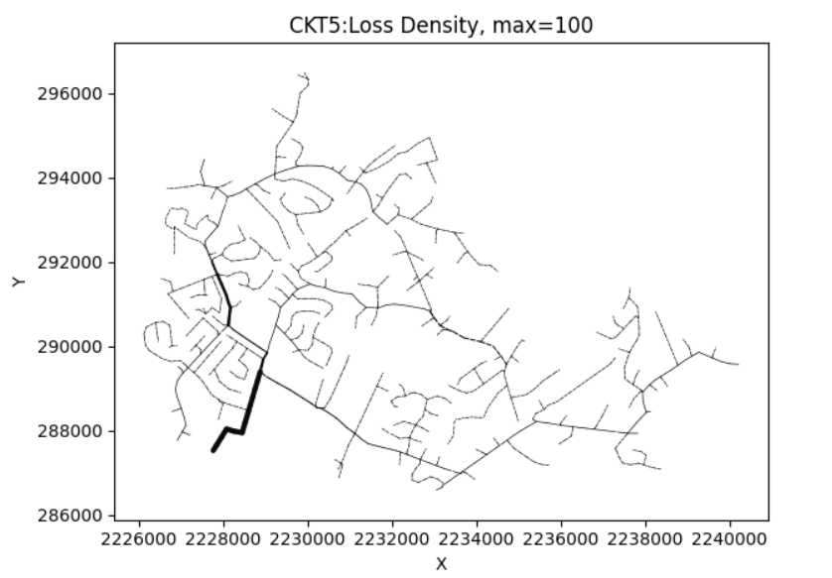
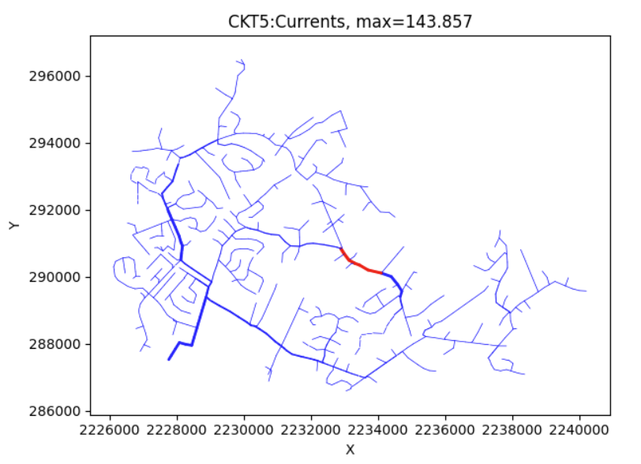
Tommy - Work
Various ways to plot Circuits losses
Will be crucial in showing affects attacks have on the complete circuit
Will be sent to frontend

Slide 23
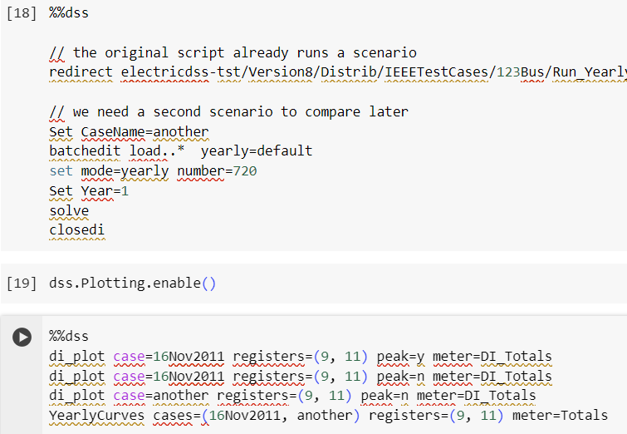
Tommy - Work
Explored an example where they set up conditions to make it a case
In this scenario they bring set up the original script and then create a separate case with different conditions
Could be used to compare plots of various attacks on top of one another

Slide 24
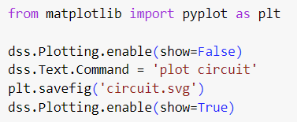
Tommy - Work
From the output section of the Google Collab I found:
Was having errors showing the plots for the Santa Fe model within VSS code so I set the show variable to false and exported it as circuit.svg
And it created!
How do I now view this?
Documentation recommended Exporting to third-party software (e.g. use Inkscape to complement SVG files) to edit it

Slide 25
Tommy - Next Week
Figure out how to download the figures in a certain area and view them
On Wednesday’s team meeting determine what plots are the most important and should be on the frontend

Slide 26
Meeting Minutes

